Slide 1
Sound Frequencies
Deb was talking last week about the power of words and intentions
We have been looking at sound and frequencies and essential oils and their emotional impact on us
This is part of expanding our consciousness and renewing our minds so the truth can set us free

Slide 2
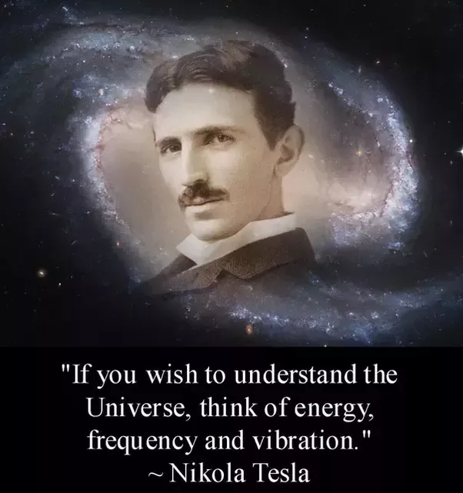

Slide 3
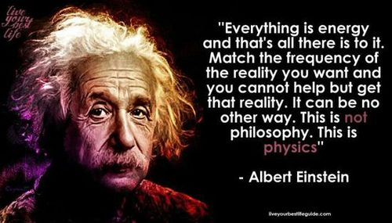

Slide 4
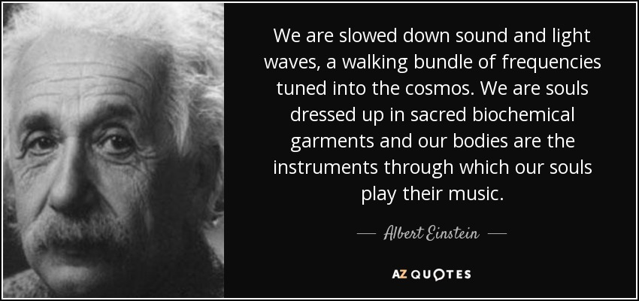

Slide 5
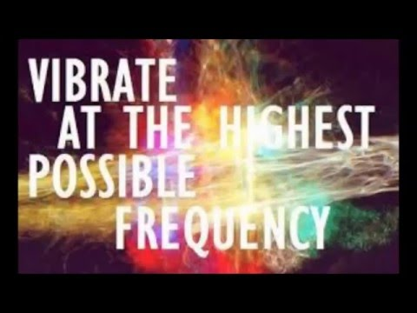

Slide 6
Sound Frequencies
God is spirit, God is love and God is light
God’s is pure creative light that is beyond the speed of created light
Love is the very essence of God’s nature and is the highest frequency that exists and we are God’s sons made in His image to love and be loved

Slide 7
Sound Frequencies
We are spirit light frequency beings living a human being experience
Our soul and spirit are composed of light which is electromagnetic energy that exists but can’t be seen with our natural eyes

Slide 8
Sound Frequencies
Creation was spoken into existence with sound electromagnetic energy and continues to exists through the power of God’s voice
God’s grace is the strings of vibrating energy within the fabric of everything
Everything is connected and powered by zero point energy from another spiritual, quantum or non-local dimension

Slide 9
Sound Frequencies
There are dimensional realities that exist that are non-local and invisible to our natural eyes
Heb 11:3 By faith we understand that the worlds were prepared by the word of God, so that what is seen was not made out of things which are visible.

Slide 10
Sound Frequencies
Col 1:15 He is the image of the invisible God, the firstborn of all creation. 16 For by Him all things were created, …. all things have been created through Him and for Him. 17 He is before all things, and in Him all things hold together.
How?

Slide 11
Sound Frequencies
Heb 1:3 And He is the radiance of His glory and the exact representation of His nature, and upholds all things by the word of His power.
Energy vibrating at a frequency holds creation together from a spiritual or quantum realm which is connected to us – some of you is there now

Slide 12
Sound Frequencies
There are many dimensions that exist that we can’t see which is the mathematical foundation of string theory “the theory of everything”
We are spirit beings with the capacity to engage those spiritual dimensions

Slide 13
Sound Frequencies
This room is filled with electromagnetic energy vibrating at frequency that you can’t see naturally e.g. radio waves, TV waves
We can tune into those waves with the right technology to hear and see

Slide 14
Sound Frequencies
There are higher frequency spirit beings (angels) that are in this room we can’t see them with our physical eyes but we can tune the eyes of our heart and spirit to sense them and see them
We are designed to be able to engage and connect spiritually

Slide 15
Sound Frequencies
God has given us a strategy to help fulfil our mandate to engage people and help them exchange their old DIY lives for their true identity and destinies as sons of God
Alternative Christian Therapies using light, sound, crystals, fragrances and oils are part of that strategy

Slide 16
Sound Frequencies
Aroma Touch
RTE releasing toxic emotions using essential oils
Forgiveness therapy
Truth and identity therapy
Light and crystal therapy
Sound therapy using crystal bowls

Slide 17
Sound Frequencies
Sound Healing, through various techniques and technologies, is the educated and conscious use of the energy of sound to reach identified goals and promote wellness in the human system – including mental emotional and physical health

Slide 18
Sound Frequencies
Sound Healing is founded on the premise that all matter is vibrating at specific frequencies.
Science has proven that sound, or vibration, has a strong impact upon substance.
For example, the study of Cymatics has shown how sound creates geometric patterns in matter.

Slide 19
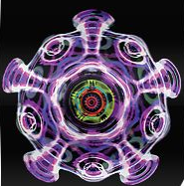
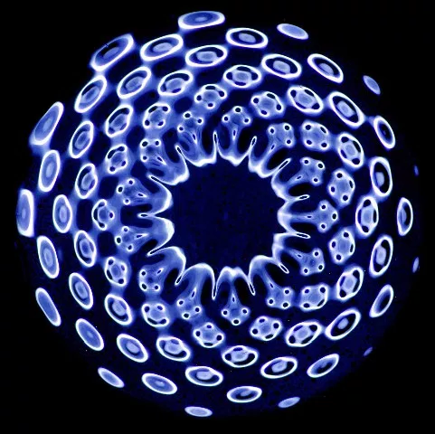

Slide 20
Sound Frequencies
Dr. Emoto has proven that sound affects the molecular structure of water. We are approx 70% water
Sound also affects consciousness are brains are approx 80% water
Many ancient civilizations and modern indigenous cultures have used sound to heal and access higher levels of consciousness for thousands of years.

Slide 22
Sound Frequencies
Research has now shown that each of us has a root or soul frequency that we vibrate at.
This frequency is most apparent when we are centred and grounded in rest or in love.
The frequency also naturally emanates from us when we are in a state of rest or peace as an energy field

Slide 23
Sound Frequencies
Matt 11:28 “Come to Me, all who are weary and heavy-laden, and I will give you rest. 29 Take My yoke upon you and learn from Me, for I am gentle and humble in heart, and you will find rest for your souls.
Rest, peace, trust and true identity comes in relationship with Jesus

Slide 24
Sound Frequencies
There are many frequencies that distract us from our own.
There are sounds of everyday life phones, cars, trucks, trains, planes, electricity, and electromagnetism.
There are the chaotic and distracted frequencies of disconnected people all around us.

Slide 25
Sound Frequencies
Probably the most difficult frequencies are the distracting frequencies within us -- such as chaotic and stressful thoughts and emotional pains and trauma memories connected to our past and brokenness and causing disharmony and fragmentation

Slide 26
Sound Frequencies
With all the chaos and inconsistency around us, it is easy to lose our frequency and peace by being influenced by the prevailing atmospheres over and around us
We can overcome these problems by coming to Jesus to find rest and health for our souls and bodies

Slide 27
Sound Frequencies
One goal of using sound frequencies is to help people regain their identity by penetrating their limited and resistant mind-sets with truth
Why don’t we use normal Christian methods of healing?
Who says these are not normal from God’s perspective?

Slide 28
Sound Frequencies
Jesus used many different ways to heal people
Some were instant miracles but some an ongoing therapeutic processes
Jesus used words, energy fields, power, touch, spit, mud, directives, commands and rebukes to heal

Slide 29
Sound Frequencies
When any frequency is resonated within us, our root frequency is naturally triggered in relation to our Soul frequency.
Resonant agreements begin to take place at a subconscious level
Changes can begin to take place, things reconnect, memories open up and realignment can occur

Slide 30
Sound Frequencies
Although this is a subconscious reaction different conditions can alter the affect it has on us
Psychosomatic effects work through the interaction of mind and body.
Faith, belief or fear can have a positive or negative effect

Slide 31
Sound Frequencies
Many other clinical studies (covered in Lynn McTaggart's book, "The Intention Experiment") have proven that our intention not only affects matter, it affects ourselves and others.
Healing experiment even worked in the past

Slide 32
Sound Frequencies
Quantum Physics actually explains how this works. It is all based on the main law of resonance
"A strong resonant frequency will overcome and entrain a weaker frequency into the same vibration as the stronger."

Slide 33
Sound Frequencies
Even an intention is vibration.
Some intentions are very pure, like sending love to someone. Some are more complex frequency combinations
Since intention is simply a frequency, the strength and quality of the intention contribute to its effectiveness.

Slide 34
Sound Frequencies
If you hold an intention of healing love for someone in need, it will be exponentially more powerful when you hold it without distraction.
If you can hold the intention for an extended period of time with a heavenly focus – the “as it is in heaven” then manifestations will occur on earth as agreed in heaven

Slide 35
Sound Frequencies
It has also been proven that intention gets embedded into things like recorded music.
So when you play back the music it is carried by the sound to the listener.
Paul imparted into physical material to minister to people at distance

Slide 36
Sound Frequencies
E=mc² energy = mass x speed of light squared
The equation says that energy and mass (matter) are interchangeable; they are different forms of the same thing. Under the right conditions, energy can become mass, and vice versa.

Slide 37
Sound Frequencies
We can learn through the power of our conscious thoughts and words to create and choose a better reality for ourselves
When connected spiritually to a higher power or reality and a higher dimension our consciousness can change our reality for the better

Slide 38
Sound Frequencies
Sound energy affects matter. Every Geometrical shape corresponds to a sound mathematically.
In fact, many believe that the information embedded in a sound, is the information that actually creates the shape of everything in nature.

Slide 39
Sound Frequencies
In nature, we find patterns, designs and structures from the most smallest unseen particles, to things seen by human eyes, to the greater cosmos.
These inevitably follow geometrical patterns, which reveal to us the nature of each form and its vibrational resonances.

Slide 40
Sound Frequencies
Through connecting to frequency we can tune into creation and reconnect to our relationship with the whole of the created order
Connecting to the sacred geometric foundation of everything
We connect to creation as sons of God to answer its groan

Slide 41
Sound Frequencies
The images are often called sacred geometry because they are part of the actual structure of the entire universe.
God is the designer and creator
The flower of life has every single component of reality imbedded in this one image which is connected to the tree of life and Metatron’s cube

Slide 42
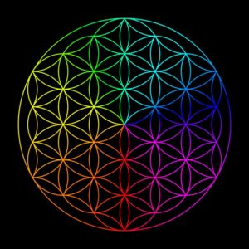

Slide 43
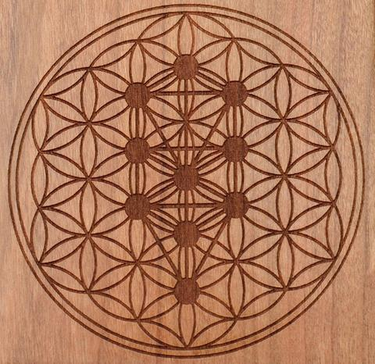

Slide 44
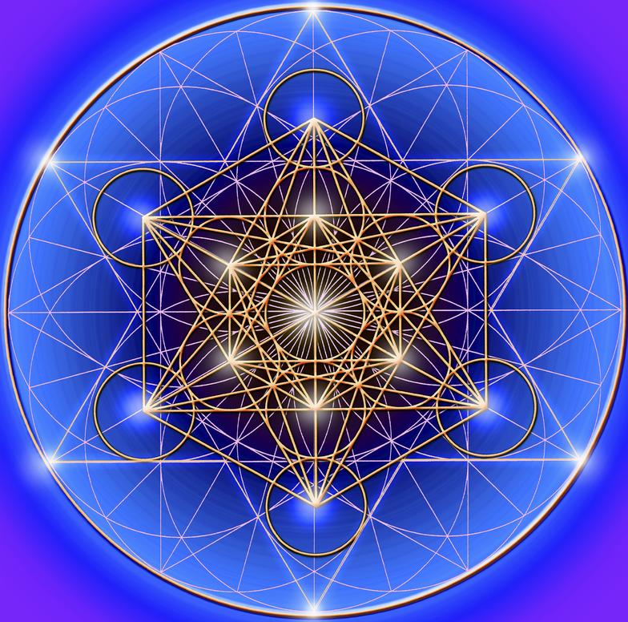

Slide 45
Sound Frequencies
The Golden Spiral is based on the Golden Mean ratio. This ratio is found throughout all life. Phi = 1.618…..
Also, when a person is transmitting love, the heart actually creates a sound that is made up of golden mean harmonics.

Slide 46
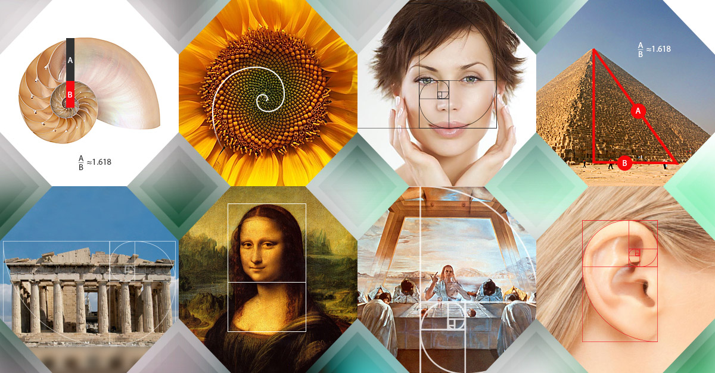

Slide 47
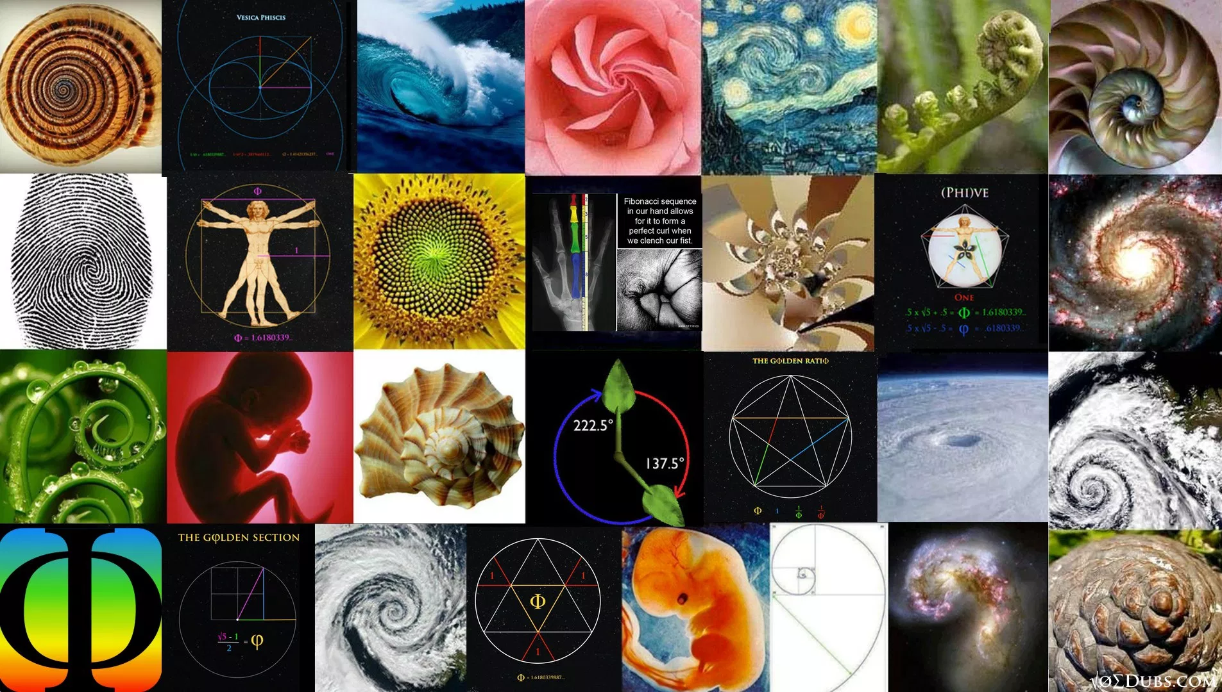

Slide 48
Sound Frequencies
Creation in its original form was harmonious and everything played its part in an amazing symphony of colour, sound and frequency all vibrating in unison
With Satan's rebellion and the fall of man aspects of creation became discordant groaning and waiting for restoration

Slide 49
Sound Frequencies
There are many types of sound that can resonate intent -- frequencies, pitches, beats, musical intervals, music and energy.
There are many people using different frequencies within musical composition and sounds with intent for different purposes like healing, realignment harmony, unity, love, joy and peace

Slide 50
Sound Frequencies
The most common musical interval used to express love and healing is the musical third (the 528Hz frequency is a musical third)
713HZ is known as the resurrection frequency and is restorative – music in 713Hz

Slide 51
Sound Frequencies
We are quite familiar with the natural music of love, which often has some sadness and melancholy about it because of mankind's lostness and brokenness
Music can connect us emotionally to the intent and memory

Slide 52
Sound Frequencies
The Blues, Blue grass, Jazz, Classical affects our mood and therefore our emotions
Rock, pop, Dixieland, boogie-woogie, big band, swing, bebop, 'straight-ahead,' acid-jazz, fusion, and metaphysical and these can stir up many different emotions, such as sadness, happiness, and excitement.

Slide 53
Sound Frequencies
Crystal bowls contain the qualities of amplification, storage, transfer, and transformation, they can be powerful tools in effecting change in ones life with intention
It is important to approach the use of the bowls with intention flowing through the frequency of the notes.

Slide 54
Sound Frequencies
Crystals are biblical and were used for divine guidance
God gave the gemstone breastplate to the high priest, Aaron, to help him spiritually discern answers to the people's questions that he asked God while praying in the tabernacle.

Slide 55
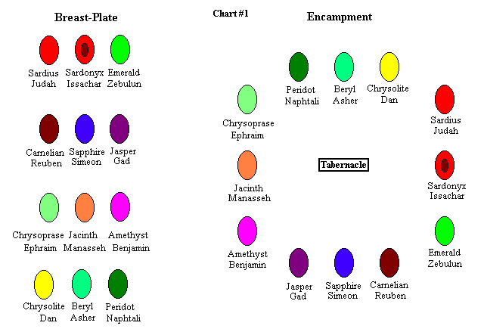

Slide 56
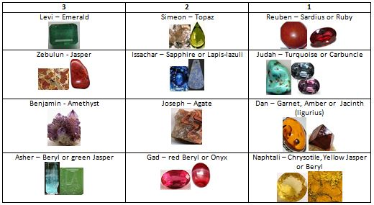

Slide 57
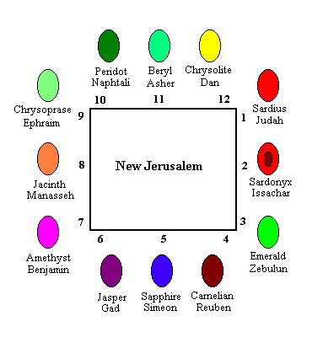

Slide 58
Sound Frequencies
Exodus 28:30 mentions mystical objects called "Urim and Thummim" (which mean "lights and perfections") that God instructed the Hebrew people to include in the breastplate: so they may be over Aaron’s heart whenever he entered the presence of the Lord.

Slide 59
Sound Frequencies
Our brain is vibrating at different frequencies with different wavelengths Alpha, Beta, Theta and Delta waves
We can learn to focus our brain waves to be more effective through meditation and mindfulness techniques

Slide 60
Alpha brainwaves move towards deep relaxation, imagination and intuitive thinking
Beta brainwaves are engaged when the brain is aroused or processing activities
Theta brainwaves can indicate drowsiness, daydreaming, the first stage of sleep or 'indirect' imagination/thinking
Delta brainwaves can reveal deep sleep or slow-wave 'background' thinking.

Slide 61
Sound Frequencies
The brain has the capacity to operate on more than one frequency range at any given time.
All four rates occur at once, yet at varying amplitudes. A good analogy would be to relate each brainwave state to a sting on a violin. All four strings make notes, yet one or more strings can dominate the overall sound at a greater volume.

Slide 62
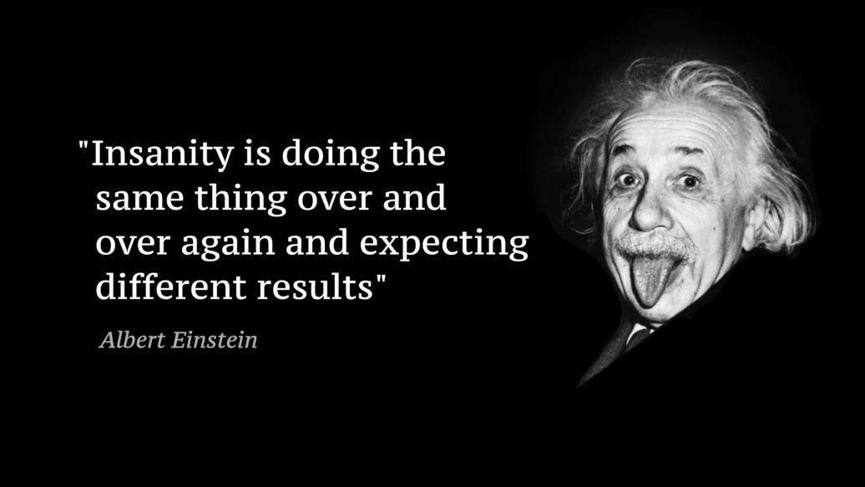

Slide 63
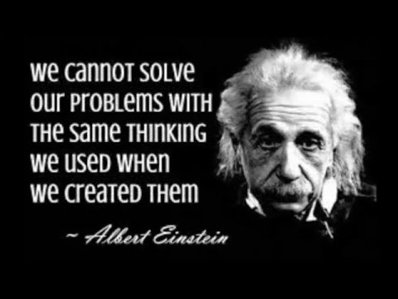

Slide 64
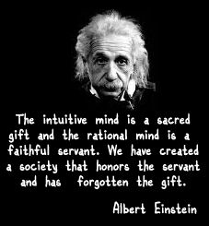

Slide 65
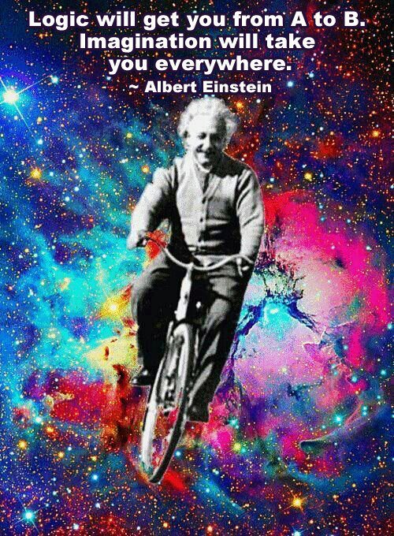

Slide 66
Sound Frequencies
Sound and colour are both forms of energy, which vibrate.
As the vibration of sound becomes higher and lighter, the sound is transmuted into colour.
A normal piano spans a bit more than seven octaves.

Slide 67
Sound Frequencies
If, hypothetically, we could extend the piano keyboard another 35 to 50 octaves higher, the keys at the higher end would produce colours, rather than audible sounds, when played.
Creation is groaning in B-flat 57 octaves below the lowest b-flat on piano that sound even comes from black holes

Slide 68
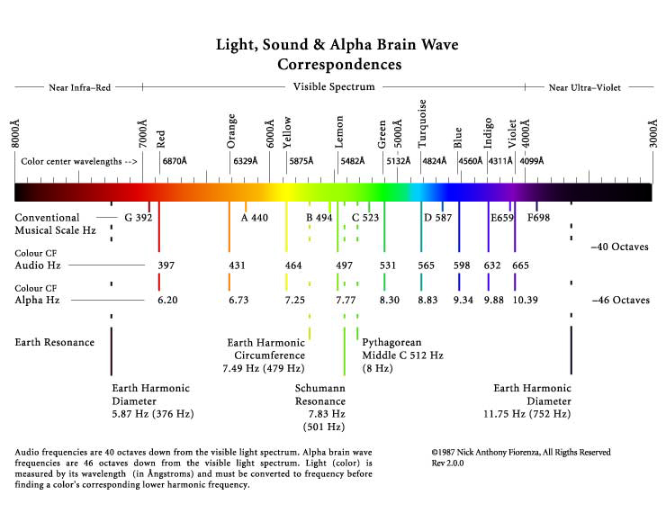

Slide 69
Sound Frequencies
The crystal bowls emit a sound which is a powerful, pure resonance.
The larger bowls are much more reverberant, with the tone lingering longer, simply because of the size and amount of crystal.

Slide 70
Sound Frequencies

Slide 71
Sound Frequencies
The bowls can be played with intent in different ways using different implements and techniques by flowing through the spirit
Flow of intent for healing or peace etc. is released in the same way as we speak words

Slide 72
Sound Frequencies
C RED
D ORANGE
E YELLOW
F GREEN
G BLUE
A INDIGO
B VIOLET

Slide 73
Sound Frequencies
C RED 264hz
D ORANGE 300Hz
E YELLOW 336Hz
F GREEN 353Hz
G BLUE 402Hz
A INDIGO 444Hz
B VIOLET 484Hz

Slide 74
C Red
264Hz

Slide 75
D Orange 300Hz

Slide 76
E Yellow 336Hz

Slide 77
F Green 353Hz

Slide 78
G Blue 402Hz

Slide 79
A Indigo 444Hz

Slide 80
B Violet
484Hz

Slide 81
Sound Frequencies
C RED SPIRIT LORD
D ORANGE WISDOM
E YELLOW UNDERSTANDING
F GREEN COUNSEL
G BLUE MIGHT
A INDIGO KNOWLEDGE
B VIOLET FEAR OF LORD

Slide 82
Sound Frequencies
C RED PROPHET
D ORANGE SERVANT
E YELLOW TEACHER
F GREEN EXHORTER
G BLUE GIVER
A INDIGO RULER
B VIOLET MERCY

Slide 83
Sound Frequencies
C RED CONSCIENCE
D ORANGE IMAGINATION
E YELLOW REASON
F GREEN MIND HEART
G BLUE EMOTIONS
A INDIGO WILL
B VIOLET CHOICE

Slide 84
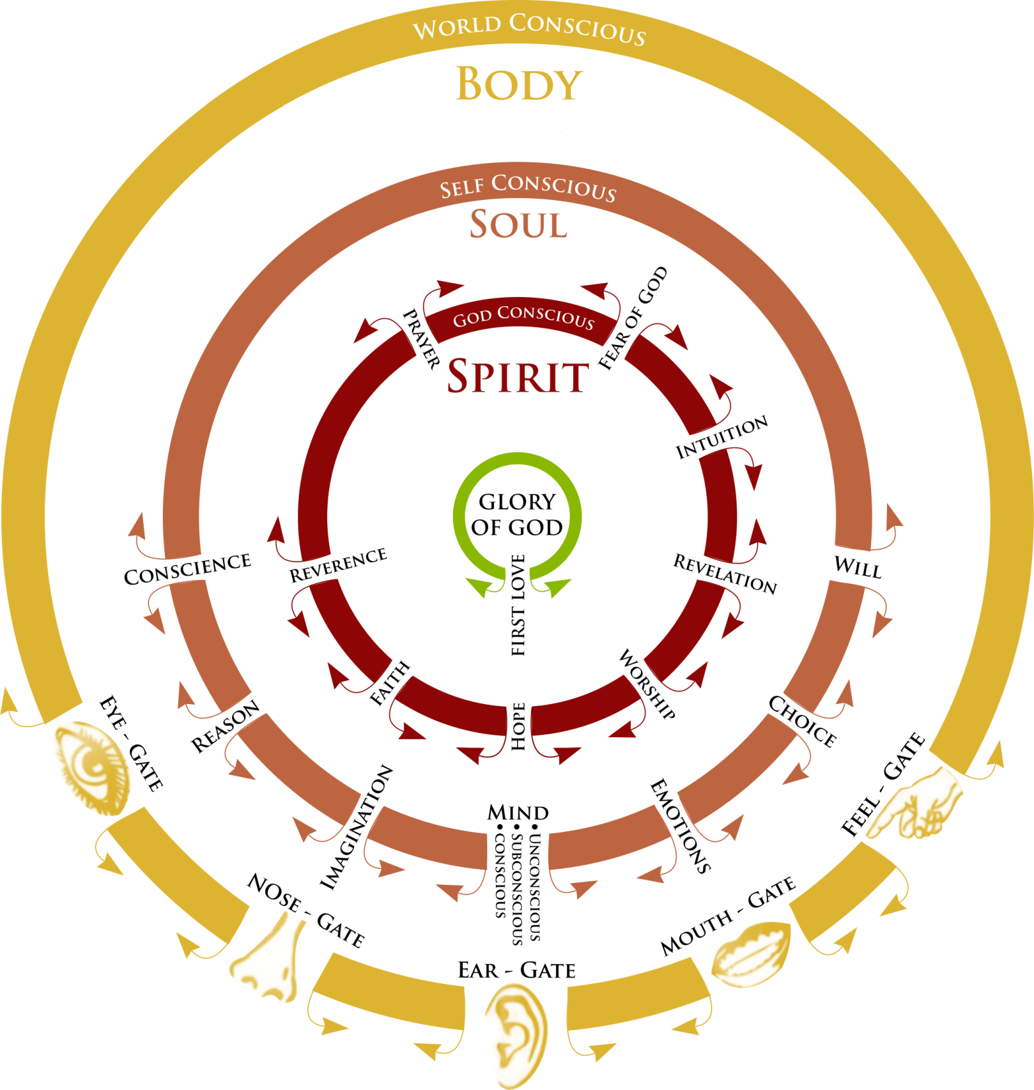

Slide 85
Sound Frequencies
C RED ROOT
D ORANGE SACRAL
E YELLOW SOLAR PLEXUS
F GREEN HEART
G BLUE THROAT
A INDIGO IMAGINATION
B VIOLET CROWN MIND

Slide 86
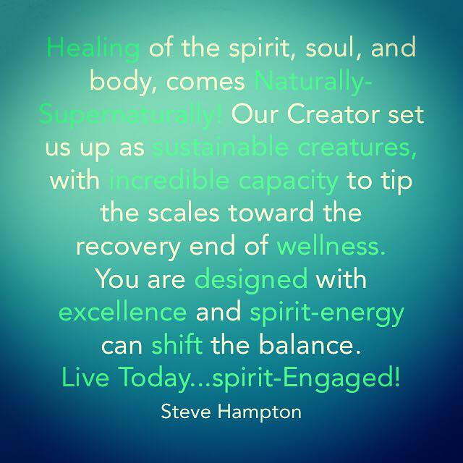

Slide 87
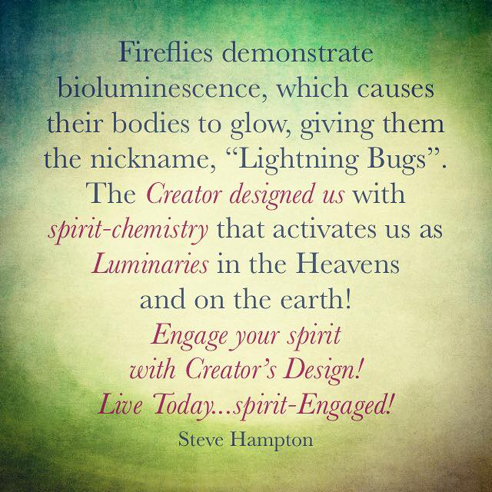

Slide 88
Sound Frequencies
Health is the state of coming into balance and harmony with our identity and destiny as sons
As thought forms are energy, the intention with which one approaches healing work is of utmost importance.
Intention is a clearly formed thought that is released intentionally

Slide 89
Sound Frequencies
Rom 8:19 For the anxious longing of the creation waits eagerly for the revealing of the sons of God. 21 that the creation itself also will be set free from its slavery to corruption into the freedom of the glory of the children of God.
We need to become healthy and whole spirit, soul and body for creation to respond to our sonship and be set free

Slide 90
Tune and engage your spirit to the frequency of the Father’s words on the carrier wave

Slide 91
Tune and engage your spirit to the healing frequency on the carrier wave

Slide 92
Tune and engage your spirit to the intention released on the carrier wave

Slide 93
Sound Frequencies
What are chakras?
At the inner core, spin seven wheel-like energy centres called chakras.
They are measurable patterns of electromagnetic activity, centres for the reception, assimilation and transmission of life energies. Each chakra reflects essential aspects of consciousness,

Slide 94
Sound Frequencies
Mark Virkler
First, I don’t see any truth as being a “New Age truth”. All truth is God’s truth! He is the all-knowing One, and He reveals His knowledge to ALL, even evil men (or New Agers, or Hindu or Chinese, or Americans).

Slide 95
Sound Frequencies
For example, God gave Pharaoh, the evil king of Egypt, dreams of seven fat cows and seven skinny cows (Gen. 41), which gave him wisdom as to how to provide for his kingdom for the next 14 years.

Slide 96
Sound Frequencies
So just because an evil king, or a New Ager, a Hindu or an agnostic American has received some insight, I still call it God’s insights.
I never bother to ask if New Agers or unbelievers believe something or not, as it is irrelevant to me what they believe.

Slide 97
Sound Frequencies
I do not live in reaction to them or in rejection of what they know. I live in God’s truth, and for sure, they can and do pick up some of God’s truth, and that is not a problem to me.
So for example, I believe in aerodynamics, as do many New Agers.
Not a problem as far as I can see.

Slide 98
Sound Frequencies
Second, there is nothing in the Bible that specifically discusses chakras. We cannot point to a specific verse that mentions the word chakra to give us God’s view on the topic.
So then I ask the question, “Do chakras violate any biblical principle, or are they compatible with any biblical principles?”

Slide 99
Sound Frequencies
We should start by defining “chakra” so we know exactly what we are talking about.
Let’s go with the following working definition if we can: “Chakras are believed to be centres of energy, located on the midline of the body.
There are seven of them, and they govern our psychological properties.”

Slide 100
Sound Frequencies
Chakras are considered both transmitters and receivers of energy. “Meridians” are energy pathways in the body which this energy flows through.
The idea is that one must have balanced chakras and meridians in order to be physically, emotionally, mentally and spirituality healthy.

Slide 101
Sound Frequencies
A body can get problems in different areas with blockage or instability in either the chakras or meridian pathways.
So do we run on energy?
Are there energy pathways in our bodies?

Slide 102
Sound Frequencies
We know for sure there are pathways for blood in our bodies, and pathways for nerves, and pathways for lymph, so why wouldn’t God have created pathways for energy to flow through our bodies?
I have no problem believing that He did.

Slide 103
Sound Frequencies
I have no problem believing we are energy organisms, infused by God’s divine energy, for the Bible declares that God is all and in all (Col. 3:11) and in Him all things hold together (Col. 1:17).

Slide 104
Sound Frequencies
Our school science class taught us that all atoms have electrons spinning around them, and that it is the flow of electrons that produce energy and current.
Beyond any doubt science has confirmed that we are energy beings on the molecular level.

Slide 105
Sound Frequencies
I suspect it may be possible that chakras are spiritual energy centres that receive and release the spiritual life force of Almighty God in and out of our physical and spiritual beings.
I know when Jesus laid hands on to heal, there was a flow of God’s energy from Him into those He prayed for (Mk. 5:30),

Slide 106
Sound Frequencies
So I see the release of the healing anointing to include the release of God’s energy into our bodies to right things that are messed up.
So for me, I believe in energy and energy pathways.

Slide 107
Sound Frequencies
Now if I were going to limit God to being simply a mass of energy, rather than a personal loving God (as some religions do), then I would object to that.

Slide 108
Sound Frequencies
God is much more than a flow of energy.
Healing is much more than a flow of energy.
It begins and ends in the compassion of a wonderful and loving God (Mk. 6:34).

Slide 109
Sound Frequencies
So even though these energy pathways or chakras may be true, and even though Hindus (not New Agers) may have discovered these energy pathways, I would not embrace any belief that reduced God to a mere energy field.

Slide 110
Sound Frequencies
Use the frequencies and the vibrations the bowls make to release intentions
God’s words spoken over us
This is my beloved son/daughter in whom I an well please
In whom my soul delights

Slide 111
Sound Frequencies
Lot’s of words that were used last week about what the Father or Jesus would speak over you
As I speak and release those words through the sound frequency of the bowls the words go beyond your mind and penetrate your soul and spirit

Slide 112
Sound Frequencies

Slide 113
Sound Frequencies
Greek Words for Power
Biblical Reality
Contemporary Example
Authority
Exusia
God has given us authority (Exusia) to cast out demons and heal the sick
New York Power Authority – Authorized to see that power is provided to NYS residents
Power
Dunamis
The Holy Spirit provides us power(dunamis/dynamite) from God to perform these miracles
Niagara Mohawk power plant provides the power to each home
Energy
Energeo
When I speak and lay hands on the sick, I am actively releasing (energeo) God’s energy
A toaster provides an active releaseof this energy

Slide 114
Sound Frequencies
Audiovisual Stimulation (AVS) is known as an alternative therapy for many issues such as:
• ADD/ADHD
• Autism
• Seasonal Affective Disorder (SAD)
• Addictions
• Sleep Disorders
• Depression
• Migraines
• Fibromyalgia
• Reduce Stress
• Anxiety
• Chronic Pain
• PTSD
• Skin Conditions
• Weight Loss
• Chronic Fatigue
• Aid in job related stressors and issues caused by work overload
• Boost Physical performance in athletes, reduce recovery time and relieve game day stress
• Increase academic performance in students by improving memory, focus, concentration and energy, for late night study sessions without caffeine
• Increasing cognitive function in seniors, aid in stress relief and boost energy
• Effectively and naturally improve health by helping to reduce the effects of stress

Slide 115
Sound Frequencies
With The Light Labyrinth™ you can access:
Effortless meditation
Profound peace
Inner guidance
Creative inspiration
Mystical experiences
Enhanced group synergy
Exquisite resonant beauty
The Light Labyrinth™ incorporates complex computer generated programs of stunning light and color effects, which are projected into the fractal planes and fissures of medium to large quartz crystals. The carefully selected alpha and theta light form programs, which are operated by a remote control, are designed to help the meditating viewer reach gentle hypnogogic trance states.

